Slide 1
Applies Data Structure and Application
Dr Sachin K Saxena Sr Data Analyst, Portugal, MNC
Ex-Sr Software Engineer - Data Scientist

Slide 3
Content
Binary Search Trees:
Binary Search Tree (BST),
Insertion in BST
Deletion in BST

Slide 4
Binary Search Tree
Binary Search is a searching algorithm that operates on a sorted or monotonic search space, repeatedly dividing it into halves to find a target value or optimal answer in logarithmic time O(log N).

Slide 5
Binary Search Tree
Conditions to apply Binary Search Algorithm in a Data Structure
The data structure must be sorted.
Access to any element of the data structure should take constant time.
Input: nums = [-1,0,3,5,9,12], target = 9 Output: 4 Explanation: 9 exists in nums and its index is 4

Slide 6
Binary Search Tree
The basic idea is to repeatedly divide the search interval in half until the target value is found or the interval is empty.
By using this approach, we can quickly eliminate half of the remaining search space at each iteration, resulting in a time complexity of O(log n).

Slide 7
Binary Search Tree: Complexity
Best Case Time Complexity: O(1)
The best case occurs when the target element is found at the middle of the array on the first comparison. For example,
Array: 3, 8, 15, 20, 35, 50, 75 Target: 20
In the first iteration, the middle element is checked and matches the target (20). Only one comparison is needed, resulting in a time complexity of O(1).

Slide 8
Binary Search Tree: Complexity
Worst Case Time Complexity: O(log⁡n)
The worst case occurs when the target element is either not in the array or found after repeatedly halving the search interval until it contains only one element.
Let's look at an example.
Array: 3, 8, 15, 20, 35, 50, 75 Target: 35

Slide 9
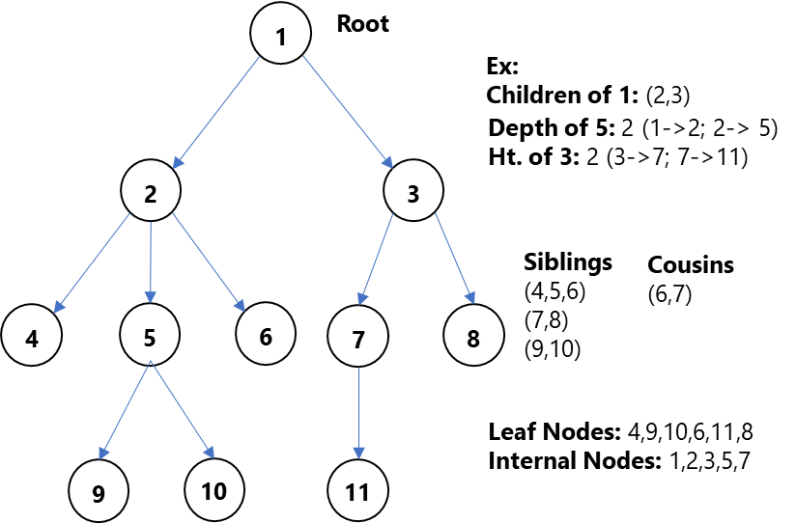
Binary Trees and their Representation

Slide 10
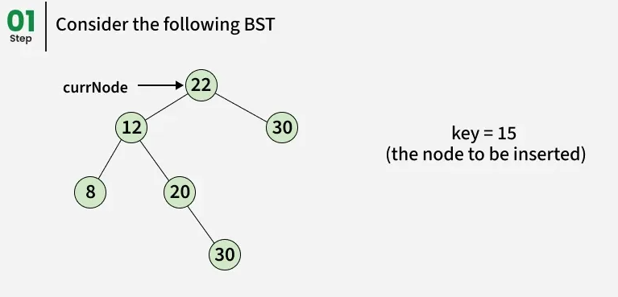
Insertion in BST
https://www.geeksforgeeks.org/dsa/insertion-in-binary-search-tree/

Slide 11
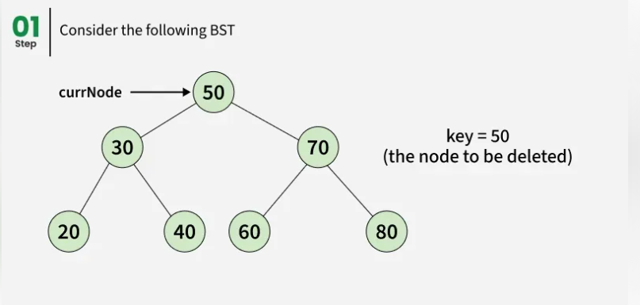
Deletion in BST
https://www.geeksforgeeks.org/dsa/deletion-in-binary-search-tree/

Slide 12
Deletion in BST
Case 1: Node has No Children (Leaf Node)
Case 2: Node has One Child(Left or Right Child)
Case 3: Node has Two Children

Slide 13
Thanking you !!!!
Any question !!!!!
Download PPT : https://github.com/sachin365123/Applies-Data-Structure-and-Application-GLA-Online-Sessions-Jan---Jun-2026

